Slide 1
《Fundamentals of Electric Circuits》
G Q Wu
Email:gqwu@ysu.edu.cn
(please turn off your mobile phone!)

Slide 2
Pre class instructions
Experiment：10%；
Materials：《电路原理》，清华大学出版社；
Reference materials：
1《电路》，邱关源主编，高教出版社
2《Electric Circuits》,James W. Nilsson,电子工业出版社
3《Fundamentals of Electric Circuits》,Charles K. Alexander,机械工业出版社
CAA：Pspice,Multisim,Tina Pro,Cadence,Matlab

Slide 3
Course introduction
1、Basic Circuit Principles
①Basic elements(R、L、C、Us、Is)
②Basic Laws(VCR、KCL、KVL)
③Methods of Analysis
④Circuit Theorem(ST、TNT)
2、Dynamic circuit Analysis(FO)
3、Sinusoidal Steady-State Analysis
4、Three-Phase Circuit

Slide 4
Chapter 1
Circuit Models and Circuit Laws
key points：
1. Reference direction
2. Voltage-Current relationship
3. Kirchhoff 's Law

Slide 5
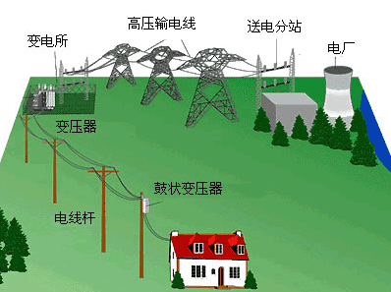

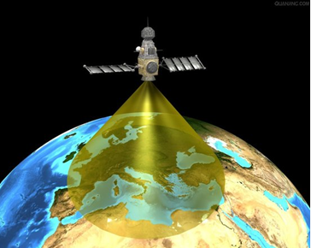
1.1 Actual Circuit and Circuit Model
1. Actual Circuit
The current path is connecting by some electrical equipment and components in a certain way , also called a network.
a) transmission, distribution and conversion of electricity;
b) transmit and process electrical signals
Function
Similarity
based on same circuit theory basis

Slide 6

2. Circuit Model
circuit diagram
switch
Light bulb
battery
connecting wires
It is composed of ideal circuit elements and can reflect the electromagnetic properties of actual circuits
circuit model
Ideal circuit element
An ideal element having certain electromagnetic properties

Slide 7
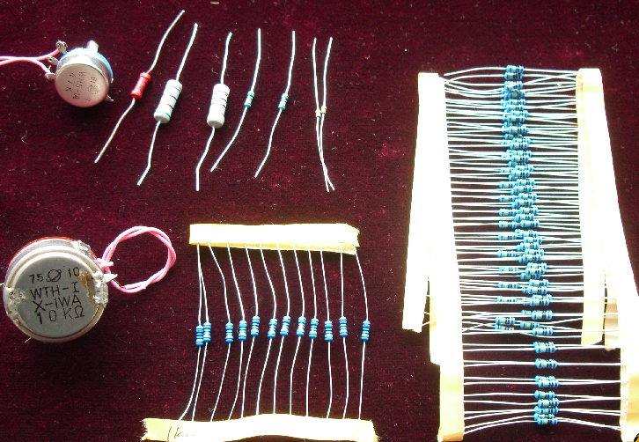
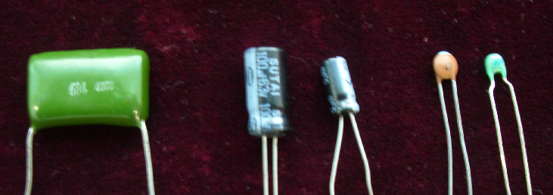
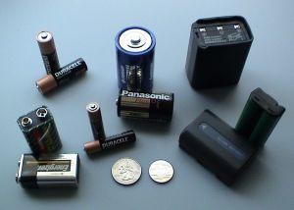
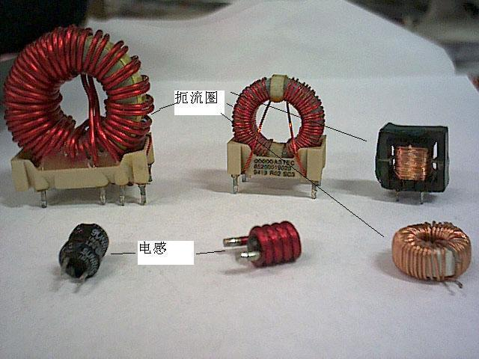
Several basic circuit elements：
Resistor：
A device that consumes electrical energy.
Inductors：
A device that produces a magnetic field and
stores its energy.
Capactors：
A device that generates an electric field and
stores its energy.
Power source：
A device that converts other forms of energy
into electrical energy.

Slide 8

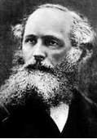
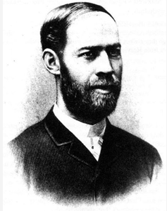
Example:
3. Lumped parameter circuit
A circuit composed of lumped elements
Lumped conditions
d: dimensions of circuit elements
λ: working wavelength

Slide 9
1.2 Reference Direction and Power
1. Current Reference Direction
Current
regular directional movement of electric charge
Current Intensity
the amount of charge passing through the cross-section of a conductor in unit time

Slide 10
1kA=10³A
1mA=10⁻³A
1 μ A=10⁻⁶A
Units
A（Ampere）、kA、mA、μA
Direction
the direction of positive charge movement
Two possibilities for the actual direction of the current:
⊕
actual direction
A
B
⊕
actual direction
A
B
question:
When the current in a complex circuit changes with time, the actual direction is often difficult to judge.

Slide 11
Current Reference Direction
randomly assume one direction of positive charge movement
i reference direction
A
B
Reference Direction and Actual Direction ：
i reference direction
i reference direction
A
B
A
B
actual direction
actual direction
i > 0
i < 0

Slide 12
Two representations of current reference direction ：
• arrow：
current reference direction: the direction of the arrow
i
A
B
• double subscript：
e.g. i_{AB} , current reference direction: A to B
i_{AB}
A
B

Slide 13
2. Voltage Reference Direction
Electric Potential ϕ
Charge q from circuit is moved to the reference point (ϕ = 0) when the size of the electric field force to do work
Voltage U_{ab}
The voltage U between two points is the energy needed to move a unit charge from a to b
Actual Voltage Direction
The direction of potential reduction
unit：V 、kV、mV、μV

Slide 14
Voltage Reference Direction
reference direction
U
reference direction
U
+
–
+
–
+
actual direction
actual direction
+
U
> 0
U
< 0

Slide 15
Three representations of voltage reference direction：
(1) Arrows
U
(2) positive and negative polarity
+
U
-
(3) double subscripts
U_{AB}
A
B

Slide 16
3. Associated Reference Direction
U , I of components or branch use the same reference direction is called an associated reference direction. Conversely, it is called an nonassociated reference direction
i
i
+
U
-
-
+
U
associated reference direction
nonassociated reference direction

Slide 17
Example:
Reference direction of voltage and current as shown in the figure，Is the reference direction of voltage and current associated in part A and Part B?
i
＋
answer： A: nonassociated；
B: associated.
A
A
U
B
B
－
note:
(1)Speccify reference direction;
(2)Do not change arbitrarily;
(3)“-”

Slide 18
4. Electric Power
The work done by the electric field force per unit time.
unit of power：W (Watt)
unit of energy： J (Joule)

Slide 19
5. Circuit Absorbed or supplied Power
u, i Reference direction associated
+
P=ui implies element is absorbed power
P>0 absorbed positive power (absorbed power )
u
i
P<0 absorbed negative power (supplied power)
-
u, i Reference direction nonassociated
-
P = ui implies element is released power
u
P>0 released positive power (supplied power)
i
P<0 released negative power (absorbed power)
+

Slide 20
Example
Find the power absorbed or supplied to all circuit element：
U1=1V, U2= -3V,
U3=8V, U4= -4V,
U5=7V, U6= -3V
I₁=2A, I₂=1A,
I₃= -1A
+
U1
－
U6
－
+
1
6
I1
+
－
+
2
4
5
U2
U4
U5
－
－
+
I2
I3
3
－
+
U3
answer：
P₁=U₁I₁=1×2=2W(supplied)
P₄=U₄I₂=(-4)×1=-4W(supplied)
P₂=U₂I₁=(-3)×2=-6W(supplied)
P₅=U₅I₃=7×(-1)=-7W(supplied)
P₃=U₃I₁=8×2=16W(absorbed)
P₆=U₆I₃=(-3)×(-1)=3W(absorbed)
note:
In a complete circuit，supplied power＝absorbed power

Slide 21
1.3 Resistor、Independent source、Dependent source
1. Definition
1.3.1 Resistor
resistor
Current limiting element
u
voltage-current
characteristic
i
2. Linear time-invariant resistance element
u ∝ i
R
symbol

Slide 22
Voltage Current Relation(VCR)
Ohm's law
u
i
R
u、i take the associated reference direction
i
+
－
u
unit
R ：resistance，unit：Ω (Ohm)
G :conductance ，unit： S (Siemens)
Video presentation

Slide 23
note:
(1) Linear resistors R is constant
Ohm’s Law
(2) nonassociated : “-”
(3) memoryless and bidirectional
R
i
-
+
u
Then Ohm's law is written as
u = –R i i = –G u
Formula and reference direction must be used together!

Slide 24
3. Power and Energy
Power：
R
i
p = u i= i²R =u² / R (absorbed)
-
+
u
R
i
p = u i= (–R i) i= -i² R
= u(–u/ R) = -u²/R (absorbed)
-
+
u
Resistors absorbed power at all times

Slide 25

Energy：
Energy consumed by the resistance from t to t₀:
4. Open-Circuit and Short-Circuit of resistance
u
short-circuit
+
i
i
u
R
–
open-circuit

Slide 26



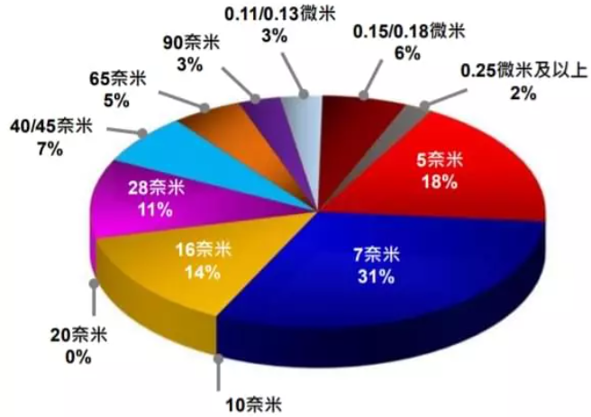
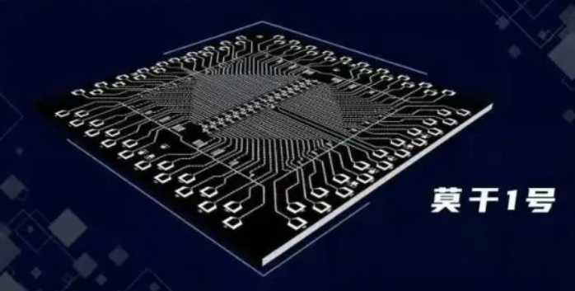
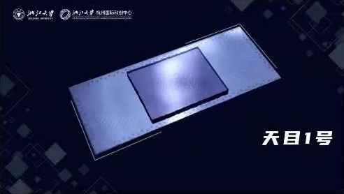

On September 14, 2022, Shanghai enterprises achieved mass production of 14 nm advanced process scale, and breakthroughs were made in 90 nm lithography machine, 5 nm etcher, 12 inch large silicon chip, domestic CPU and 5G chip.
Superconducting quantum chip
Notes:
2022年9月14日，上海企业实现了14纳米先进工艺规模的批量生产，在90纳米光刻机、5纳米蚀刻机、12英寸大硅芯片、国产 CPU 和5G 芯片等领域取得了突破。

Slide 27
1.3.2 Independent Source
1. Ideal Voltage Source
definition
The voltage is constant, indepenent of its current
circuit symbol
i
_
+

Slide 28
VCR
u
(1) Constant voltage
(2) The current through the voltage source depends on the power and external circuit。
i
example:
i
+
R
-
external circuit
The voltage source cannot be short circuited!

Slide 29
The power of the independent voltage source
i
+
（1） u , i nonassociated
+
u
_
P=u_{s}i
supplied power
_
i
+
+
（2） u , i associated
u
absorbed power
_
_

Slide 30
Example:
Calculate the power of each element in the diagram
_
Solution:
+
+
+
5V
10V
_
_
i
P_{10V}=u_{s}i=10×1=10W
supplied
P_{5V}=u_{s}i=5×1=5W
absorbed
absorbed
P（supplied）＝P（absorbed）

Slide 31
The actual voltage source
i
VCR
+
+
u
u_{s}
_
u
O
i
_
A good voltage source
Internal resistance
The actual voltage source shall not be short circuited！

Slide 32
2. Ideal Current Source
definition
The current is constant, indepenent of its voltage
symbol
_
+
u
u
VCR
(1) Constant current
i
(2) Voltage between its two terminals of curent source depends on the power and external circuit。

Slide 33
Example:
+
R
u
-
external circuit
Current source cannot be opened！

Slide 34
The power of the independent current source
+
（1） u , i nonassociated
u
P=ui_{S}
supplied power
_
+
（2） u , i associated
u
absorbed power
_

Slide 35
Example:
Calculate the power of each element in the diagram.
answer:
i_{S}=2A
+
+
2A
5V
u
_
_
P_{2A}=ui_{S}=5×2=10W
(supplied)
P_{5V}=ui_{S}=5×2=10W
(absorbed)
P（supplied）＝P（absorbed）

Slide 36
Actual Current Source
i
+
u
u
i_{s}
_
O
i
A good current source
Internal resistance
The actual current source cannot be opened！

Slide 37
1.3.3 Dependent Source
(controlled source )
1. definition
An ideal dependent (or controlled) source is an active element in which the source quantity is controlled by another voltage or current.
symbol
+
–
controlled voltage source
controlled current source

Slide 38
2. Classification
(1) Current-Controlled Current Source ( CCCS )
i₁
i₂
four terminals elements
+
+
u₁
u₂
β : Current amplification factor
_
β i₁
_
input：control source
output：controlled source

Slide 39
(2) Voltage-Controlled Current Source ( VCCS )
i₁
i₂
+
+
u₁
u₂
_
gu₁
_
g: Transfer conductance
(3) Voltage-Controlled Voltage Source ( VCVS )
i₁
i₂
+
+
+
u₁
μu₁
u₂
μ: Voltage amplification factor
_
_
-

Slide 40
(4) Current-Controlled Voltage Source ( CCVS )
i₁
i₂
+
+
+
r : Transfer resistance
u₁
ri₁
u₂
_
_
-
Example:
Circuit model

Slide 41
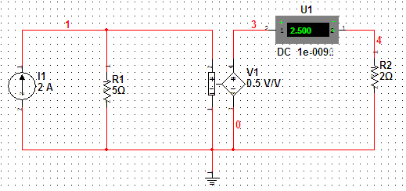
3. Comparison
(1) The independent source voltage (or current) is determined by the source itself , while the controlled source voltage (or current) is determined by the control quantity.
(2) The independent source generates voltage and current in the circuit, while the controlled source only reflects the relationship between output and input.
Example:
I_{S}=2A，U₂=0.5U₁，R₁=5Ω，R₂=2Ω，find I_{2。}
I₁
I₂
solution:
I_{S}
+
+
U₁
R₁
U₂
R₂
-
-

Slide 42
1.4 Kirchhoff’s Laws
Kirchhoff’s current law( KCL )
Kirchhoff’s voltage law (KVL)

Slide 43
1. Terms
（1） Branch
The same current . (b)
i₁
i₃
a
+
+
u_{S1}
u_{S2}
b=3
_
_
R₃
i₂
R₁
R₂
n=2
b
(2) Node
A node is simply a point of connection of three or more branches. ( n )

Slide 44
(3) Path
A path between two nodes.
(4) Loop
A closed path.
+
+
3
u_{S1}
u_{S2}
l=3
_
_
1
2
R₃
R₁
R₂
(5) Mesh
A loop that does not contain any branches.
The mesh is a loop，But the loop does not have to be a mesh.

Slide 45
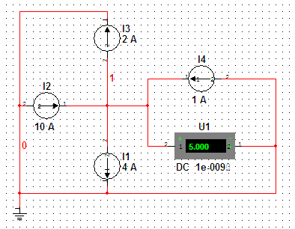
2. Kirchhoff’s Current Law (KCL)
or
Example:
output is“+”，so：
??

Slide 46
Example:
1
2
sum：
3
KCL is applicable to closed surfaces containing multiple nodes.
note:
（1）Charge conservation and Current continuity ;
（2）The current reference direction .

Slide 47
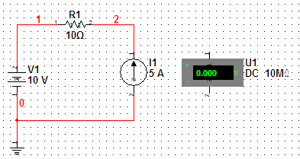
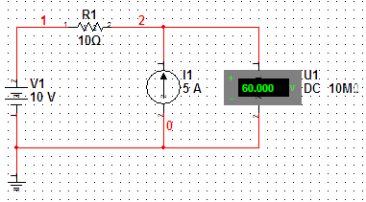
3. Kirchhoff ’ s voltage law (KVL)
or
or
I₂
（1）Calibrate the voltage reference direction of each element
R₂
（2）Select the direction of the loop, clockwise or counterclockwise.
+
U2
U_{S1}
–U₁–U_{S1}+U₂+U₃+U₄+U_{S4}= 0
_
U3
R₃
R₁
U1
or：
U₂+U₃+U₄+U_{S4}=U₁+U_{S1}
I₁
I₄
U4
I₃
–R₁I₁+R₂I₂–R₃I₃+R₄I₄=U_{S1}–U_{S4}
_
R₄
U_{S4}
+

Slide 48
example:
a
+
U₁
-
+
U₂
_
+
U_{s}
KVL is applicable to hypothetical loop.
_
b
Note:
（1） The conservation of energy;
（2）The voltage reference direction .
Example1-4,1-5

Slide 49
4. Summary of KCL、KVL ：
(1) KCL is a linear constraint on the branch current and KVL is a linear constraint on the loop voltage.
(2) KCL and KVL are independent of the components that make up the branch.
(3) KCL shows that charge is conserved at each node; KVL embodies the conservation of energy.
(4) KCL and KVL are only applicable to lumped circuits.

Slide 50
1.
2.
u =?
3.
4V
4.
3Ω
-
4V
i =?
-
+
-
-
+
+
3Ω
1A
+
-
+
-
5V
5V

Slide 51
I₁
I =?
4V
-
5.
6.
+
+
+
10A
3A
10Ω
1A
2Ω
+
10V
-10V
U =?
-
I
-
-
3I₂
5Ω
+
I =0
7.
-
I₂
+
+
10V
5Ω
U=?
-
5Ω
-
+
-
2I₂

Slide 52
I₁
I =?
5.
Solution:
1A
+
10Ω
+
10V
-10V
-
-
4V
-
6.
+
Solution:
+
3A
10A
2Ω
U =?
I
-

Slide 53
3I₂
5Ω
+
I =0
7.
-
I₂
+
+
10V
5Ω
U=?
-
5Ω
-
+
-
2I₂
Solution:

Slide 54
8.
Given that 1,2, and 3 are resistors and their absorption powers are 10W, 15W, and 20W respectively, determine their resistance.
9A
1
+
10W
5A
3
5V
20W
4A
2
15W
－
Solution:
R₁=10/25=0.4Ω
R₂=15/25=0.6Ω
R₃=5/4=1.25Ω

Slide 55
Homework：1-30、34、35、36

